Slide 1
Dell Systems With Intel® vPro™ Technology
November 2011

Slide 2

The Business Needs Have Changed
Therefore the Business PC Has Changed
Foreground
Video and Voice Conferencing
Flash* and Video intensive Web
Rich Content Creation
Windows* 7 + Office* 2010
Emergence of Video on Web
CRM, SCM, ERP Applications
IM + Web Browser
Collaboration
Increasing Workload: Foreground and background
Windows* XP + Office* 2007
Desktop Search
CRM, SCM, ERP Applications
Unified Messaging
2008
2011
Virus Scan
Virus Scan
Compression
Compression
Back-Up
Back-Up
System Management
System Management
Authentication/Encryption
Authentication/Encryption
Synchronization
Synchronization
Directory Services
Firewall/Intrusion-Detection
Peer-to-Peer Services
Directory Services
Java Applets
Peer-to-Peer Services
Content Subscription Services
Anti-Spyware
Background
Java Applets
Content Subscription Services
Software Update Automation
* Other names and brands may be claimed as the property of others.

Slide 3



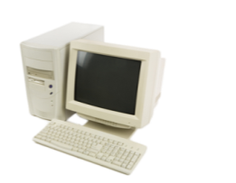



Risks Associated with Deploying Windows* 7 With Older PCs
After 3 Years, Support Costs Can Exceed Purchase Costs
PCs can cost more in support than the purchase of a new PC¹
53% More Security Incidents
On average, a 4-year-old PC can experience 53% more annual security incidents, than it did in its first year¹
24% Failure Rate
The failure rate in year four is about 24% (which is) twice the rate in year one²
$1,425 Per Out-of-warranty Repair
An out-of-warranty repair for a failed (laptop) PC is approximately $1,425²
* Other names and brands may be claimed as the property of others.
1 “Using Total Cost of Ownership to Determine Optimal PC Refresh Lifecycles”, Wipro Technologies, March 2009 (www.wipro.com/industryresearch). Based on an Intel Corporation-sponsored survey of 106 firms in North America and representing 15 different industries and projections based on a Model Company developed by Wipro Technologies. Computer system price data updated November 2009. Actual results may vary based on the number of use-cases implemented and may not be representative of results that individual businesses may realize. For additional implementation examples refer to Intel Case Studies available at http://communities.intel.com/docs/DOC-3144 2 “Keeping Notebooks Past Their Prime”, J. Gold Associates Research Report, April 2009: http://download.intel.com/business/resources/reports/keepingnotebookspastprime.pdf

Slide 4




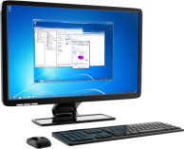




2nd Gen Intel® Core™ vPro™ Processors and Microsoft Windows* 7: Intelligent Performance for Evolving Business Needs
2008
vs.
2011
2x
Up to two times faster multitasking¹
4x
Encrypt sensitive data up to four times faster¹
60%
Runs business productivity applications up to 60% faster¹
1 Source: Comparing Intel® Core™ i5-2520M processor based laptops to theoretical installed base of Intel® Core™2 Duo Processor T7250 . Business productivity claims based on SYSmark* 2007, which is the latest version of the mainstream office productivity and Internet content creation benchmark tool used to characterize the performance of the business client. SYSmark 2007 preview features user-driven workloads and usage models developed by application experts. Multitasking claims based on PCMark Vantage, a hardware performance benchmark for PCs running Windows 7 or Windows Vista, includes a collection of various single and multi-threaded CPU, Graphics, and HDD test sets with a focus on Windows* application tests. Security workload consists of SiSoftware Sandra* 2010 -
AES256 CPU Cryptographic subtest measures CPU performance while executing AES (Advanced Encryption Standard) encryption and decryption algorithm. Software and workloads used in performance tests may have been optimized for performance only on Intel microprocessors. Performance tests, such as SYSmark and MobileMark, are measured using specific computer systems, components, software, operations and functions. Any change to any of those factors may cause the results to vary. You should consult other information and performance tests to assist you in fully evaluating your contemplated purchases, including the performance of that product when combined with other products. * Other names and brands may be claimed as the property of others.

Slide 5



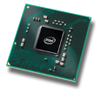

Intel® vPro™ Technology
Security, Management, and Virtualization Map to Intel® Technologies
Processor
Chipset
Network
Intel® Core™ i5 & i7 vPro™ Processors
Intel® Q57 Express Chipset
Intel® Network
Intel® Anti-Theft Technology
Intel® Active Management Technology
Intel® Virtualization Technology
Intel® Trusted Execution Technology
Capabilities for Existing and Emerging Compute Models Meeting Your Needs Today and Tomorrow
Notes:
5
5
5

Slide 6


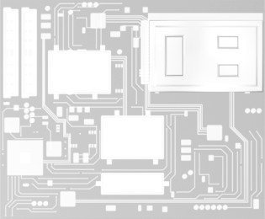
2nd Gen Intel® Core™ vPro™ Technology: The Best Platform for Business
Energy-efficient performance from the most advanced processors on the planet
Expanded management with embedded remote KVM capabilities¹, now available on all Intel® Core™ i5 and i7 vPro™ processors
Enhanced security with advances in data and asset security
Intel® vPro™ technology features now also available in Intel® Xeon® processor E3-based workstation
Intel® CoreTM i5 vProTM Processor
Processor
Chipset and Firmware
Intel® Chipset
Intel® Network Adapter
Network
Intel vPro Technology Provides Hardware-enabled Capabilities to Strengthen Security & Reduce Manageability Costs
1 Requires processor with processor graphics
Notes:
6
This slide helps explain the components of vPro visually on the left, with key features and benefits listed in bullets.
Enhanced security
Help protect data and PC asset with hardware-based platform and data disable on theft detection
Make encrypted PCs fully manageable even OOB
Expanded management capabilities
Manage client PCs “as if you were there” with embedded remote control of KVM
Save power and keep up with compliance by scheduling PCs to wake from off to run local tasks according to policy
Energy-efficient performance
Enjoy smarter performance that adapts to computing needs while optimizing power consumption

Slide 7
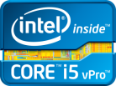
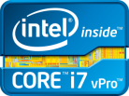
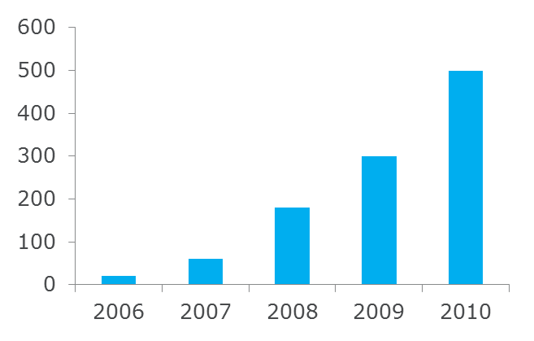
Intel® Core™ vPro™ Technology
Software Vendors Supporting Intel® Core™ vPro™ Technology²
>71% of Fortune 100 & >54% of worldwide Global 100
All leading OEMs, Service Providers/ITOs & >5000 channel
More streamlined options to configure and setup PCs. Watch demo to learn more.
Proven Technology with Increasing Support and Customers¹
1 Intel® vPro™ Technology is sophisticated and requires setup and activation
2 Source: Intel Corporation (as of August 2010)

Slide 8

Accelerate Time To Realize Value of Intel® vPro™ Technology Through Simplification Efforts
Intel vPro Technology adoption made simple and fast with Host Based Configuration
Now as easy as applying a software patch or a driver installation
Systems can be provisioned as part of standard platform deployment
Windows* PowerShell Scripts available to help automate Help Desk processes
Enables use on Intel® AMT features without having an Intel AMT capable management console
Complete predefined/simple scripts available from Intel
Learn how to deliver Help Desk value from Intel vPro Technology with Use Case Reference Designs
A complete set of pre-integrated use cases available from Intel
Example: Learn how Intel IT reduced password reset from >20 min. to ~5 min. http://communities.intel.com/docs/DOC-4800
* Other names and brands may be claimed as the property of others.

Slide 9
声明：
所有的版权属于原有公司，文件均来自公开渠道
此文件仅供学习使用，任何人不得进行以此为商业目的的行为
如有疑问，请立即删除
学习世界五百强和咨询公司PPT课程请访问如下网站搜索：“司马懿”
百度传课：司马懿PPT学校
网易学堂：司马懿PPT学校
知乎： 司马懿PPT学校
访问地址
https://www.chuanke.com
访问地址
https://study.163.com
访问地址
https://www.zhiu.com

